Slide 1
Have you had your daily dose?
Nelson Diaz, Erin Hanson, Alan Lai, Tyler Lisowski

Slide 2
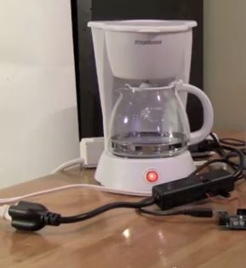
Project Description
User tweets using coffee pot handle.
Coffee pot periodically checks for tweets.
Parses data from user.
Power relay on.
Coffee pot acknowledges user.

Slide 3
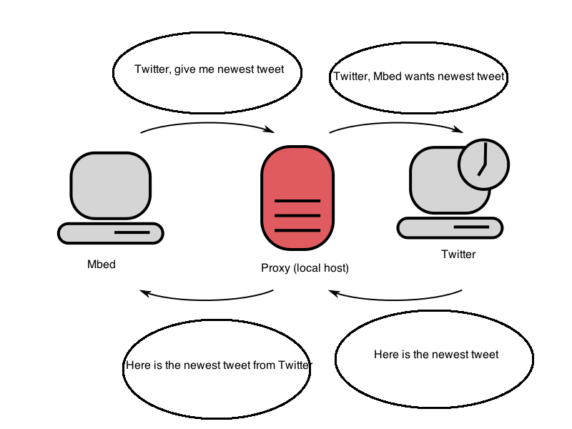
MBED + TWITTER

Slide 4
Behind the Scenes
Signal Machine is ready (pushbutton)
Check for new tweet
Notify tweeter of action
Handle brewing Process (if necessary)

Slide 5
MBED Protocol
0
Machine not ready (no coffee or water)
1
Machine ready to brew
2
Machine currently brewing
3
Machine is getting set to brew
5
Initialization state (get tweet ID to compare against

Slide 6
Twitter Pot in Action!
http://mbed.org/users/tlisowski3/notebook/twitter-coffee-pot/

Slide 7
Future Work
Implementing threads to decrease wait time
Completely autonomous system
Forget Twitter! We make our website for interfacing
Make an APP!!! (for Android and Apple)

Slide 8
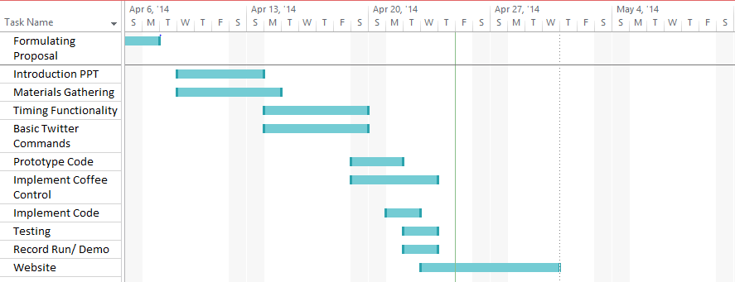
Gantt Chart

Slide 9
Questions, Comments, Concerns??????

